Slide 1
FINANCIAL AID UPDATES For the 2021-2022 School Year

Slide 2
ABOUT OASFAA AND THIS PRESENTATION
OASFAA is a non-profit organization comprised of financial aid professionals. The OASFAA Outreach Committee is an all-volunteer committee that serves as a primary resource of pertinent and current financial aid information. The committee disseminates this information through a variety of activities including training programs for various stakeholders external to OASFAA such as admissions staff, high school counselors, access advisors, TRIO, etc.
OASFAA has provided the information today as a free service to counselors.
You have permission to copy and distribute these materials to your students and families. Charges may not be assessed for the material or for the information presented. Permission must be granted for other use of this information or these materials. Contact the OASFAA Outreach Chairperson(s) listed on the OASFAA website or e-mail the OASFAA Outreach Committee at: outreach@oasfaa.org.

Slide 3
THE COVID-19 IMPACT ON FINANCIAL AID
CARES Act: Coronavirus Aid, Relief, and Economic Security Act provides support to colleges for their students in the form of Emergency Grants as the result of the disruption in campus operations due to the coronavirus. Schools who accept the funds must exhaust them by September 30, 2021.
$6 billion in emergency funds directly to students in higher education
Students must be Federal Aid Eligible to receive emergency grants
Emergency grant must be paid directly to the students and not applied toward any outstanding charges
Awarding criteria beyond aid eligibility was left to the school’s discretion
Some used an application, some awarded across the board
Some schools are still awarding, some have exhausted their funds

Slide 4
FAFSA PROCESSING NUMBERS

Slide 5
OHIO FAFSA NUMBERS
Ohio Class of 2020 completed 73,442 FAFSA’s compared to Class of 2019 that completed 78,271. That is a 6.2% decrease (as of 7/31/2020).
Nationally, the Class of 2020 has completed 4.1% fewer FAFSAs than last year’s class.
Total number of FAFSAs completed for Ohio for the 2020-2021 academic year is 494,540. FAFSAs completed this time last year was 514,280. This is a 3.8% decrease (as of 8/28/2020).
Notes:
That slide is here to get them to think about whether they access this data. If they don’t, we should suggest they reach out to ODHE to get instructions for accessing the data for next year.

Slide 6
ACCESSING OHIO FAFSA DATA
https://www.ohio-k12.help/fafsa/
Must sign an agreement to access data
Can designate who has access to the data
Website contains running dashboard of Ohio FAFSA numbers
Contains roster of districts that have agreements on file
Allows you to have student-level data for targeted outreach
Many enhancements since last year and more coming this October
Indicates which students were selected for verification

Slide 7
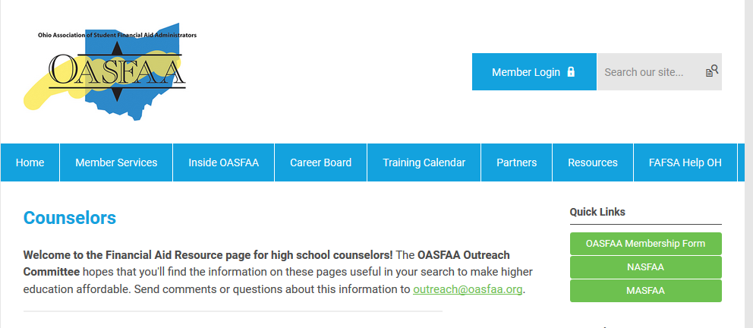
OHIO FAFSA COMPLETIONS YEAR OVER YEAR
NCAN’s Form Your Future
https://www.oasfaa.org/counselors
Notes:
In the meantime you can get on this in early October and see what your numbers look like for 2021-2022.

Slide 8
FINANCIAL AID CHATBOT
The College Board created a FAFSA chatbot https://www.getfafsahelp.org/cb/
Made available nationwide this spring due to the pandemic
Contracted advisors will be available to respond to difficult student questions that CHATBOT cannot answer
Available through September 30 to everyone
Starting October 1: for the 21-22 FAFSA, student will have to sign up for the Opportunity Scholarship program at College Board to have access to the tool

Slide 9
TESTING CHANGES RELATED TO ADMISSIONS AND SCHOLARSHIPS

Slide 10
TEST OPTIONAL VS. TEST BLIND
What is the difference?
Test Optional allows students to be considered for admission without having to take or submit a standardized test score.
However, schools may still factor in a standardized test score for admission/scholarship if a test has been taken and/or submitted.
Keep in mind that schools can still acquire test scores, even if the student does not submit the score to the school themselves.
Test Blind means the school does not factor test scores into admissions/scholarship decisions, regardless of whether a test was taken and/or scores submitted.

Slide 11
TESTING CHANGES
College and university admission-based scholarships
Colleges and universities will likely take one of two paths for admissions-based academic scholarships: require a test score or utilize GPA only.
It’s likely nothing changes if a school still requires a test score.
Students may still have to submit an ACT/SAT score to be considered for an admissions-based academic scholarship.
A school will likely tighten GPA “bands” if they utilize GPA only.
Example: a school who previously awarded a top-tier scholarship to students with an ACT score of 30+ and a GPA of 3.80+ may now offer the same dollar amount to students with a GPA of 3.92+.

Slide 12
TESTING CHANGES
Colleges may lean more heavily on cumulative GPA than in the past.
They may also look closely at the composition of the high school transcript.
Did the student take Advanced Placement, honors or college courses while in high school?
Did the student utilize a pass/fail option during Q4 of the 2019 - 2020 academic year?
Was pass/fail optional or mandated?
If optional, can the student speak to why they exercised that option?

Slide 13
TESTING CHANGES
An essay or personal statement will probably be required.
We anticipate many colleges will use a holistic approach to admissions and merit-based scholarship decisions.
Advise students to review all college websites for admissions criteria regarding test optional and test blind.
OACAC is working on a ‘testing’ survey of colleges and universities

Slide 14
FAFSA UPDATES FOR 2021-2022

Slide 15
FEDERAL STUDENT AID ID (FSA ID)
https://fsaid.ed.gov
An FSA ID is a username and password that gives a student/parent access to Federal Student Aid’s online systems and serves as their legal signature.
The student and one parent whose information is on the FAFSA will need their own individual FSA IDs.
It is best to request FSA IDs before beginning the FAFSA.
FSA ID requires an email address or mobile phone number. An email address and mobile number can only be associated with one FSAID. Parents and students cannot use the same email or mobile phone number.
Students should not use a high school email address because it will be deleted after graduation.

Slide 16
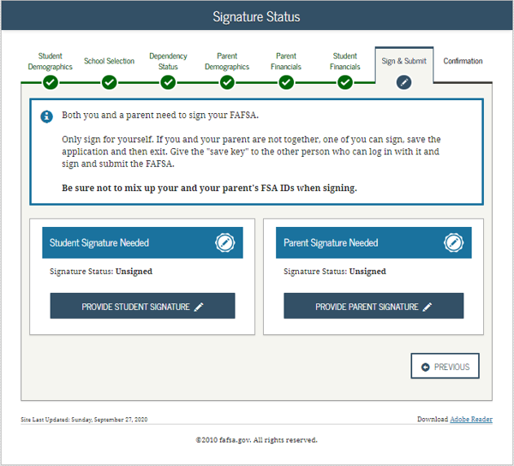
PARENT AND STUDENT SIGNATURE
The most common reason a submitted FAFSA is considered incomplete is missing signatures.
Students and parents are encouraged to request the FSA ID prior to beginning the FAFSA.

Slide 17
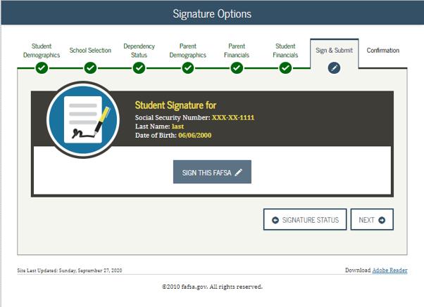
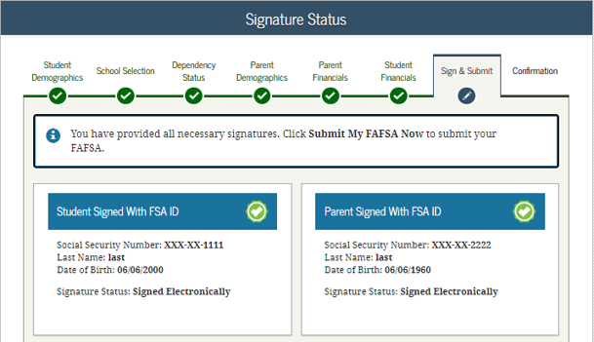
PARENT AND STUDENT SIGNATURE

Slide 18
CHANGES TO THE 2021-2022 FAFSA
Elimination of 1040A/EZ resulted in removal of a question from the FAFSA
Replaced with “Did (or will) you file a Schedule 1 with your 2019 tax return?”
See FAFSA instructions on Page 9 for additional information regarding Schedule 1
This question now becomes part of the definition for Auto Zero EFC or Simplified Needs Test
If answer is no and student meets all criteria, student may qualify for Auto Zero EFC or Simplified Needs Test (fewer FAFSA questions to answer)
If answer is yes but student meets one of the 6 exemptions, they may still answer as no
This will likely be confusing for families and may result in answering a few more questions if they respond “Yes.”

Slide 19
FAFSA UPDATES FOR 2021-2022
Number of Exemptions Claimed – no longer on the tax return
IRS combined untaxed portion of IRA and untaxed portion of pensions
Question is now combined on FAFSA and rollovers are still excluded
Minor adjustments to college grade level and college degree questions

Slide 20
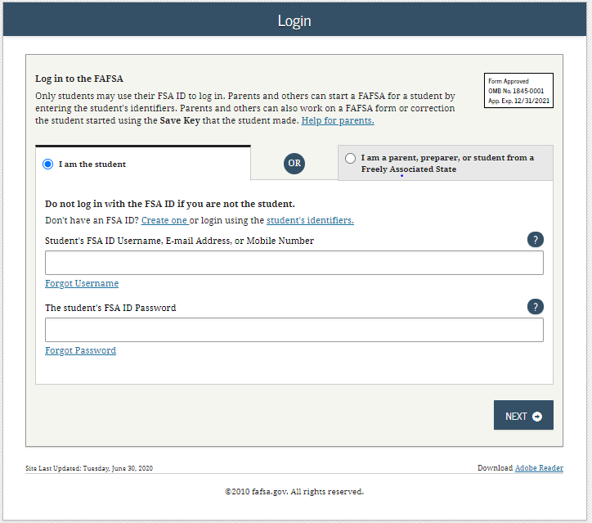
FOTW FAFSA On The Web

Slide 21
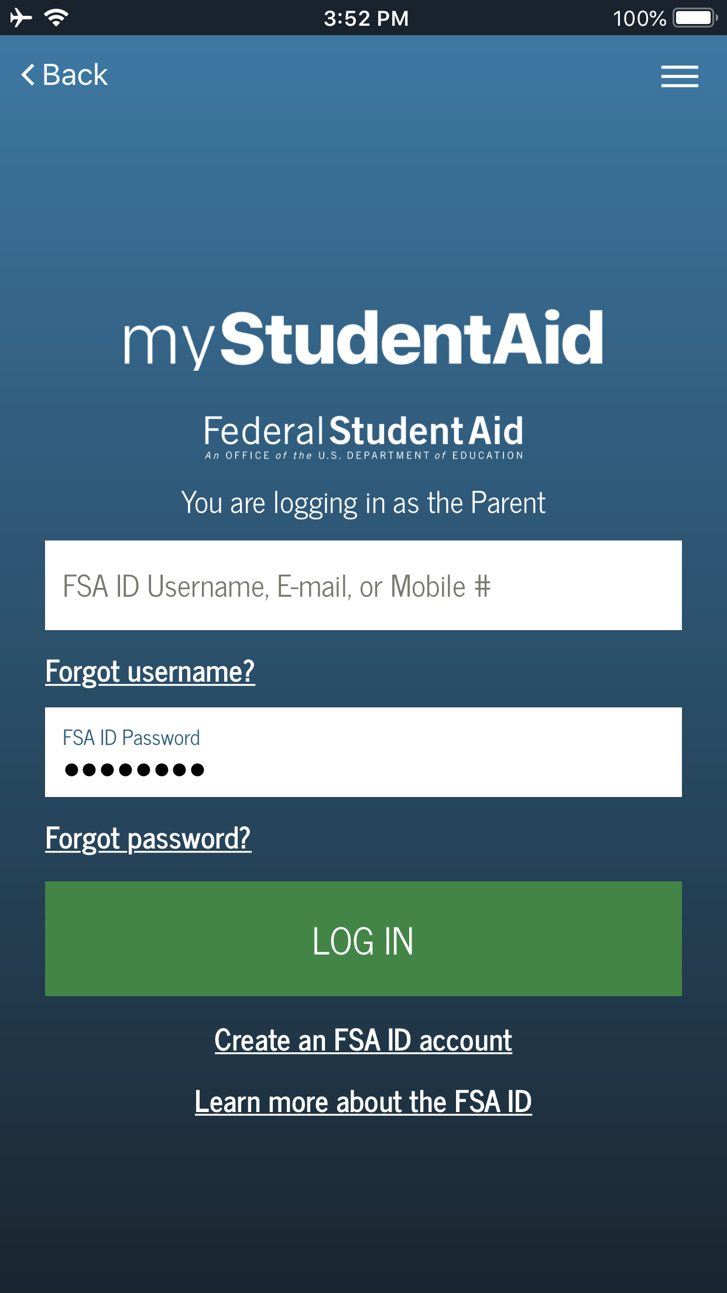
MOBILE APP UPDATES
Ready for download: FAFSA completion on myStudentAid mobile app
3% submitted a FAFSA via mobile-optimized option (phone or tablet)

Slide 22
DEPENDENCY STATUS

Slide 23
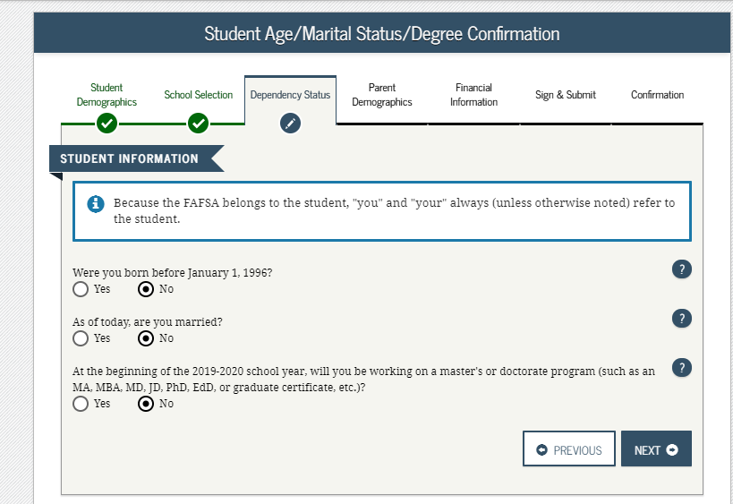
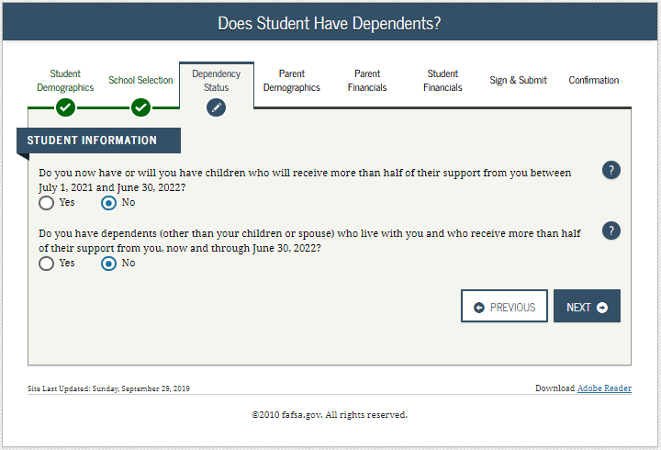
DEPENDENCY STATUS DETERMINATION

Slide 24
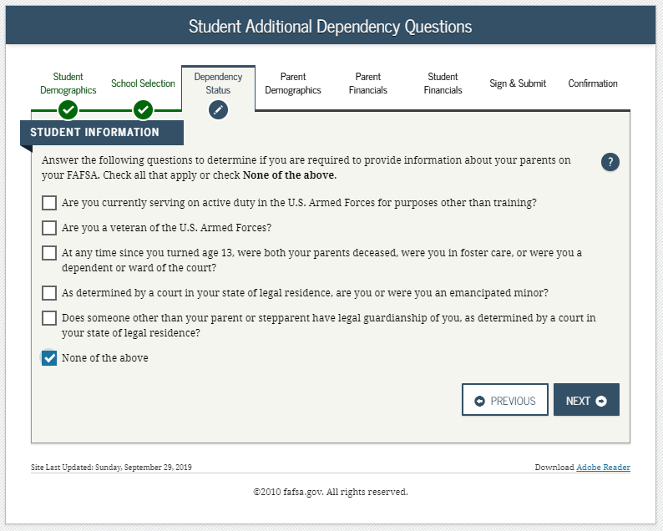
DEPENDENCY STATUS CONTINUED

Slide 25
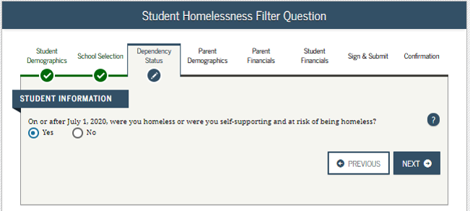
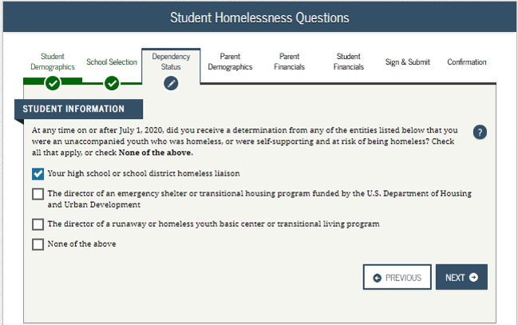
HOMELESS / AT RISK FOR HOMELESSNESS
If applicant falls in this category, they will skip parental information and be considered Independent.

Slide 26
HOMELESS / AT RISK FOR HOMELESSNESS
If applicant selects “None of the Above” on prior slide, they can proceed without parent’s information, EFC will not be calculated, and student must follow-up with the college.

Slide 27
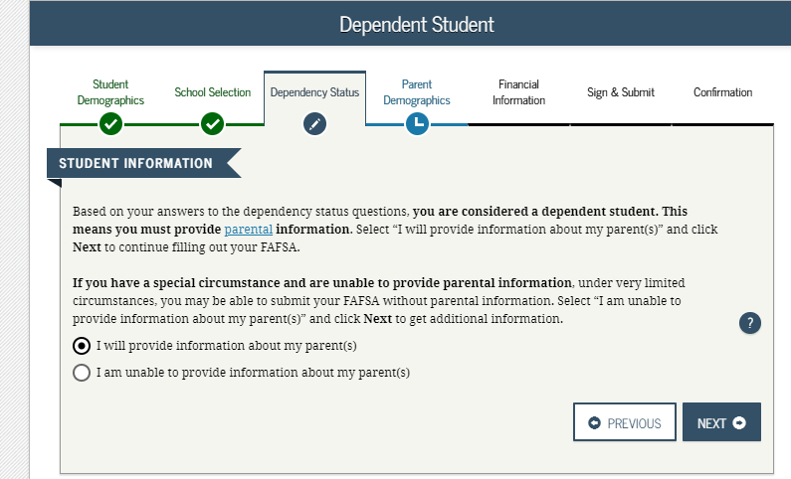
STUDENT DETERMINED TO BE DEPENDENT

Slide 28
WHO IS THE PARENT?
Parent is the legal (biological or adoptive) parent or stepparent of the student.
Parents are not married but live together.
Parents are married but are separated and living apart.
Parents are in a same-sex marriage and living together.
Parents who are non-citizens.
Notes:
Legal guardians, grandparents, foster parents are not considered the parent on the FAFSA.
Not married but living together student includes information on both parents.
Would only include the parent student lives with more than 50% of the time in the last 12 months.
Must include both parents on the FAFSA. Questions are gender-neutral.
FAFSA does not ask parents citizenship. Does not affect students aid eligibility.

Slide 29
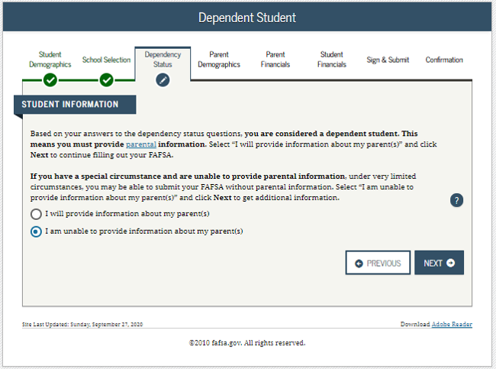
STUDENT DETERMINED TO BE DEPENDENT (SPECIAL CIRCUMSTANCES)

Slide 30
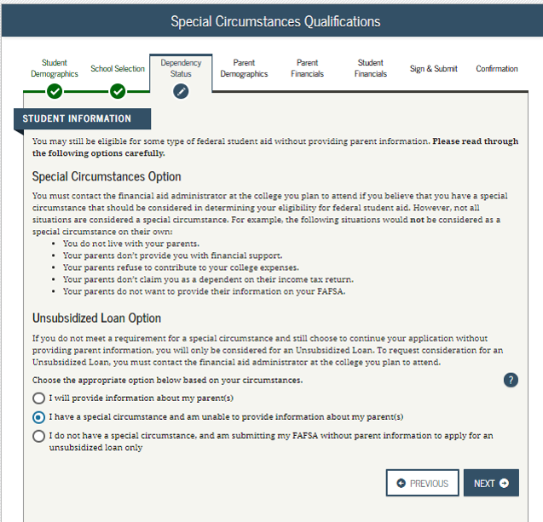
STUDENT DETERMINED TO BE DEPENDENT (SPECIAL CIRCUMSTANCES)

Slide 31
DEPENDENCY SPECIAL CIRCUMSTANCES
The following are examples of some special circumstances where a student may submit the FAFSA without providing parental information:
Parents are incarcerated
Student left home due to an abusive environment
Students does not know where parents are and are unable to contact them
The following are situations that would not be a special circumstance:
Student does not live with parents
Parents do not provide student financial support
Parents refuse to contribute to college expenses
Parents do not claim student as a dependent on tax return
Parent refusal to complete the FAFSA *School may offer a parent refusal option

Slide 32
DEPENDENCY SPECIAL CIRCUMSTANCES
A dependent student with a special circumstance may submit the FAFSA without parental information which prevents the calculation of the Expected Family Contribution (EFC).
The student should follow up with the financial aid office at the college(s) to which they have applied to explain their circumstances.
If applicable, the college will assist the student in filing a dependency appeal where they will explain and document their circumstances. If approved, the college will update the FAFSA to reflect a dependency override making the student Independent for the year.
The college’s decision is final and cannot be appealed to Federal Student Aid.

Slide 33
PARENT REFUSAL TO FILE THE FAFSA
A dependent student whose parents refuse to file the FAFSA and are not considered to have special circumstances for a dependency override.
Student submits the FASFA using the option below to be considered for an unsubsidized loan only.

Slide 34
PARENT REFUSAL TO FILE THE FAFSA
Student must provide:
Statement from parent: student does not live with parents, date parent stopped providing financial support, parents will not provide future support, parent refuses to file the FAFSA and parents are not and will not provide health or auto insurance.
Statement from student: explaining where they live, why parent will not file the FAFSA, and proof of health and/or auto insurance in student name.

Slide 35
VERIFICATION

Slide 36
VERIFICATION
Students may be selected for a process called verification and must submit documents to confirm FAFSA information.
Roughly 22% of FAFSAs are selected for verification by the U.S. Department of Education.
Students should respond quickly to any requests for information from the college.
If selected, commonly requested documents include:
Verification Worksheet (these can look different across varying colleges and universities)
Federal Tax Return Transcript or Federal Tax Return for parents/student if they filed 2019 taxes
an alternative to submitting documentation of taxes is completing the IRS Data Retrieval Process within the FAFSA
W-2(s) for parents/students if they worked in 2019 but did not file taxes
Verification of Non-Filing Letter for parents and independent students who did not file 2019 taxes – this is NOT needed for dependent students

Slide 37
VERIFICATION
Federal Income Tax Return
Institutions may accept a signed copy of the federal income tax return for the applicable tax year that the tax filer submitted to the IRS or other relevant tax authorities. (This includes a signed copy of the income tax return for amended tax filers and victims of identity theft.)
IRS Tax Return Transcripts
Institutions may accept a signed copy of the IRS Tax Return Transcript which can be requested at https://www.irs.gov/individuals/get-transcript or 1-800-908-9946
Via online account creation or request to be mailed
Can no longer have Tax Return Transcripts mailed to a third party (i.e. directly to the college or university)

Slide 38
VERIFICATION
“Will File” 2019 Taxes
If selected for verification…
School must verify that student/parent did file
Schools are only permitted to accept extensions beyond the standard 6-month extension for:
HEROES Act (Individual called upon for Active Duty or National Guard Duty) or
IRS Letter of Approval for extension beyond 6-months
If a student is not selected by the federal processor, a school may choose to institutionally select the FAFSA for verification if they have reason to question something.

Slide 39
VERIFICATION
Important to Note about Verification:
Financial Aid Administrators (FAAs) are not required to be tax experts; however, Federal Student Aid does require FAAs to know when a student or parent is required to file taxes and to verify that they filed their tax return properly.
FAAs have the authority to request that a student/parent file a tax return or amend their tax return if they determine they should have filed or filed incorrectly. Until the college receives the requested information, financial aid eligibility will not be determined.

Slide 40
SPECIAL CIRCUMSTANCES

Slide 41
OTHER SPECIAL CIRCUMSTANCES
Conditions exist that cannot be documented with the FAFSA.
Student should file the FAFSA as directed and send written explanation and documentation to the college’s financial aid office explaining their special circumstance.
Most colleges have an appeal process to address special circumstances. The college will review and request additional information if necessary.
If the student's circumstances are warranted, the FAA will submit corrections to the FAFSA to reflect the changes.
Each college may have a different way of reviewing special circumstances. Students should be prepared to appeal at all schools they are considering and could receive different responses per college.
Decisions are final and cannot be appealed to the U.S. Department of Education.

Slide 42
EXAMPLES OF OTHER SPECIAL CIRCUMSTANCES
Loss of Child Support
Unusual uncovered medical/dental expenses
Extraordinary dependent care
Parent or spouse death
Loss of employment
Divorce

Slide 43
Important Items to Mention

Slide 44
PII – PERSONALLY IDENTIFIABLE INFORMATION
Because email is not secure, students should not send SSN’s and other personally identifiable information via email. Faxing or regular mail is often ‘safer’ than using email.
Many schools have preferred ways to receive sensitive/personal information often through a secured document upload process on their web sites or portals.
As a result of the pandemic, sending documents have presented a challenge for many. Encourage students to check with their college on the best way to submit verification documents before sending/providing the information.

Slide 45
COLLEGE COMMUNICATIONS
Most institutions use a secured portal; an online resource that students can access to register for classes, view financial aid and billing.
Most institutions use a school-issued email account that students are required to activate and check regularly. Schools will begin to communicate with the student primarily through this email account once they have been admitted.
Parents should be advised that once a student enrolls in college, their student record including grades and finances becomes protected under FERPA and students would need to give parent/guardian permission to access this information if they choose.
Notes:
It is important for the counselors to prepare students and parents for FERPA and how schools are limited to what information they can give to a parent or guardian without the student’s consent.

Slide 46
Ohio Financial Aid Programs

Slide 47
OHIO FINANCIAL AID PROGRAM UPDATES
Ohio College Opportunity Grant (OCOG)
Public = $2,000
Private = $3,500
Proprietary = $1,300

Slide 48
OHIO FINANCIAL AID PROGRAM UPDATES
Ohio Safety Officer’s Memorial Fund awards will be 100% of tuition and fees at public colleges and $8,451 at private colleges.
Ohio National Guard (ONG) awards 100% of instructional and general fee charges at public institutions and up to $11,016 at private institutions.
Ohio War Orphans will be 100% of tuition and fees at public colleges and $8,575 at private colleges.
Nursing Education Assistance Loan Program (NEALP)
RN = $1,620
Nurse Educators = $6,000

Slide 49
Resources

Slide 50
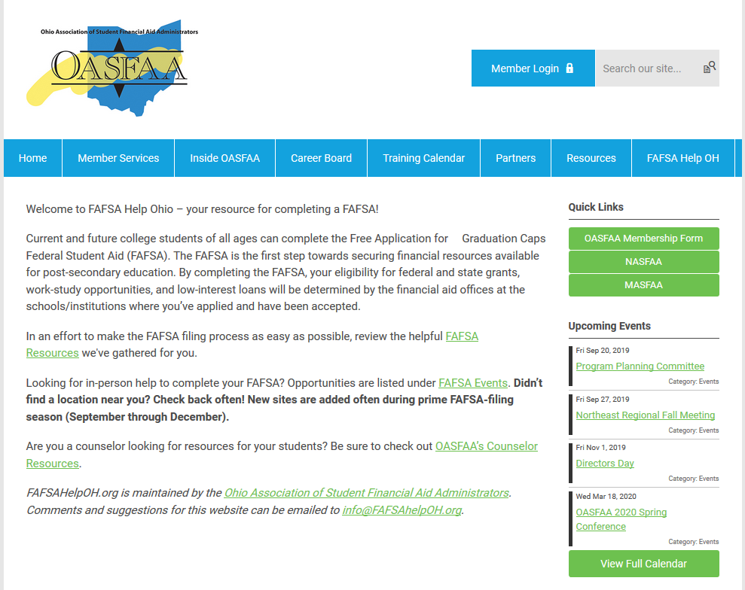
FAFSA HELP OHIO

Slide 51
RESOURCES FROM FEDERAL STUDENT AID
View and download resources from the office of Federal Student Aid (studentaid.ed.gov/sa/resources).
Publications, fact sheets, online tools, and other resources are available to help students prepare and pay for college.
Printed publications are no longer available from the U.S. Department of Education.
PDFs will continue to be available electronically.

Slide 52
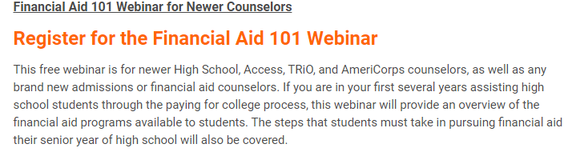
UPCOMING TRAINING FOR OHIO COUNSELORS
Financial Aid 101 Webinar
REGISTRATION IS OPEN at www.oasfaa.org
Tuesday, September 22, 2020, at 2:00 PM
Notes:
Please help us find new counselors – let them know about our upcoming webinar.
Counselors that attended today’s session but still would like a review of ALL programs available to help their students fund college may wish to attend a counselor workshop. While there will be a repeat of today’s information, the workshops are 2 ½ hours so much more comprehensive and detailed.

Slide 53
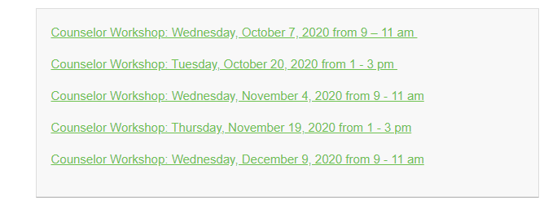
UPCOMING TRAINING FOR OHIO COUNSELORS
2020 High School Counselor Workshops
REGISTRATION IS OPEN at www.oasfaa.org
Notes:
Please help us find new counselors – let them know about our upcoming webinar.
Counselors that attended today’s session but still would like a review of ALL programs available to help their students fund college may wish to attend a counselor workshop. While there will be a repeat of today’s information, the workshops are 2 ½ hours so much more comprehensive and detailed.

Slide 54
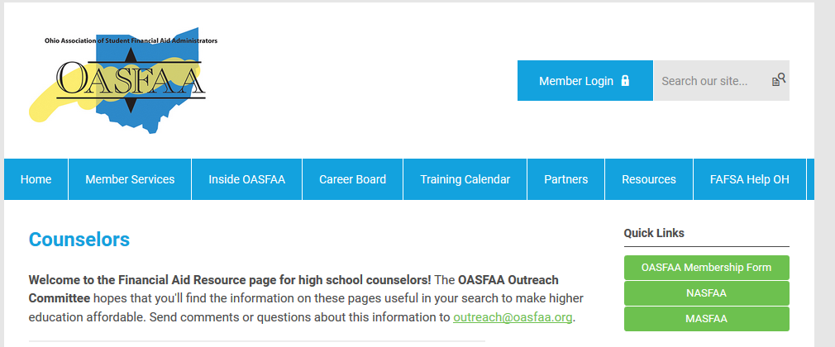
HIGH SCHOOL FINANCIAL AID NIGHTS
The OASFAA Outreach Committee can help facilitate your school’s Financial Aid presentation even virtually. If you would like a presentation, please complete a request for a presenter on the OASFAA website.

Slide 55
COLLEGE ACCESS AND SCHOOL COUNSELORS CONTACT DATABASE
Make sure you put your name and email address into our College Access and School Counselors Contact Database
at www.oasfaa.org

Slide 56
QUESTIONS?
Contact us at: outreach@oasfaa.org

