Slide 1
FINANCIAL AID UPDATES For the 2023-2024 School Year
Presented by: [presenter names here]

Slide 2
ABOUT OASFAA AND THIS PRESENTATION
OASFAA is a non-profit organization comprised of financial aid professionals. The OASFAA Outreach Committee is an all-volunteer committee that serves as a primary resource of pertinent and current financial aid information. The committee disseminates this information through a variety of activities including training programs for various stakeholders external to OASFAA such as admissions staff, high school counselors, access advisors, TRIO, etc.
OASFAA has provided the information today as a free service to counselors.
You have permission to copy and distribute these materials to your students and families. Charges may not be assessed for the material or for the information presented. Permission must be granted for other use of this information or these materials. Contact the OASFAA Outreach Chairperson(s) listed on the OASFAA website or e-mail the OASFAA Outreach Committee at: outreach@oasfaa.org.

Slide 3
FAFSA PROCESSING NUMBERS

Slide 4
OVERVIEW OF FAFSA COMPLETIONS
As of 8/19/22 – Nationally, Class of 2022 is UP 4.5% compared to Class of 2021.
Only 10 states have a decrease this year
As of 8/19/22 – In Ohio, Class of 2022 was UP 1.7% compared to Class of 2021.
As of 8/19/22 – Ohio has the 19th highest completion rate in the country with 56.2% of the Class of 2022 completing a FAFSA-down from 14th last year
Ohio Department of Higher Education offered a FAFSA22 grants to support FAFSA completion and made major improvements to the FAFSA data site
We have work to do and should probably expect a drop in higher ed enrollment again this fall.

Slide 5
TRACKING FAFSA COMPLETION
To look at aggregate number and comparison options:
www.formyourfuture.org/fafsa-tracker
Compare this year versus last year at the state, city, district or building level:
To access student-level data for Ohio: https://www.ohio-k12.help/fafsa/
Need data sharing agreement signed by superintendent.
2023-2024 FAFSA data will become available in October.
Many enhancements done this year to the Ohio site.
Notes:
Make sure the audience understands that the FAFSA tracker is aggregate numbers and for comparing the current year to the previous year. I am trying to get more info from ODHE on the process for getting student level data this year.

Slide 6
FAFSA UPDATES FOR 2023-2024

Slide 7
FEDERAL STUDENT AID ID (FSA ID)
An FSA ID is a username and password that gives a student/parent access to Federal Student Aid’s online systems and serves as their legal signature.
The student and one parent whose information is on the FAFSA will need their own individual FSA IDs.
It is best to request FSA IDs before beginning the FAFSA at www.studentaid.gov
FSA ID requires an email address or mobile phone number. An email address and mobile number can only be associated with one FSAID. Parents and students cannot use the same email or mobile phone number.
Students should not use a high school email address because it will be deleted after graduation.

Slide 8
Changes to the 2023-2024 FAFSA
Removal of Selective Service question.
Removal of drug conviction questions.
Homeless questions are renewal eligible, allowing for answers from the previous year to be carried forward.
Two-step verification method required for new FSA ID creators as part of the “Create an Account” process.
Paper FAFSA form for incarcerated students.

Slide 9
TRACKING FAFSA COMPLETION
FAFSA on the Web will include four demographic questions in a pilot voluntary survey format in order to collect feedback on the questions. This feedback will be used to inform the development of questions for 2024-2025.
What is your gender? Male Female Nonbinary Decline to answer | Are you transgender? Yes No Decline to answer | What is your ethnicity? Choose all that apply. Not Hispanic nor Latino origin Cuban descent Mexican, Mexican-American or Chicano descent Puerto Rican descent Some other Spanish, Hispanic, or Latino origin Decline to answer | What is your race? Choose all that apply. White Black or African American Asian Chinese Filipino Asian Indian Vietnamese Korean Japanese Some other Asian origin American Indian or Alaska Native Native Hawaiian or Other Pacific Islander Decline to answer
*Applicants will be advised that their answers to these questions will not affect their eligibility for federal student aid, and schools will not receive this information.

Slide 10
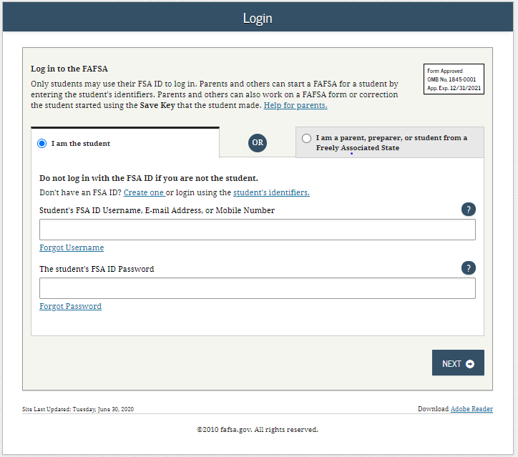
FOTW FAFSA On The Web

Slide 11
FAFSA on the web
FAFSA on the web enhancements
Login for FAFSA allows:
User to select role of student, student from freely associated state or parent or preparer.
User logged in anywhere on Studentaid.gov will not need to sign in again to access the FAFSA.
Household information updates:
If user says ‘yes’ to children or other dependents, they will be prompted on the same view to enter the number of children.

Slide 12
Fafsa on the web
FAFSA on the web enhancements
Clarification of which parent info to provide:
Parent Information, a new view, has been developed that appears at the beginning of the section to guide a user to provide correct parent information.
The view provides further details about which parent’s information should be provided based on parents’ marital status.
There is also a link to an infographic on the view to provide a visual representation of the information.

Slide 13
Fafsa on the web
FAFSA on the web enhancements
Sign and submit changes more streamlined:
Only see Preparer Information view if they chose Prepare role when they logged in.
User will be directed to sign for their role first, rather than be taken to the Signature Status view to choose which signature to provide.
If user is logged into StudentAid.gov, they will be able to sign their FAFSA from the Agreement of Terms View and will not be taken to the Signature Options view.

Slide 14
Fafsa on the web
FAFSA on the web enhancements
“Add a School” flow in current entry
Users who are eligible to complete a FAFSA Correction can now “Add a School” if only desired correction.
User selects “Update List of Colleges” from the My FAFSA view and will be able to submit these changes without signing their Correction Application.

Slide 15
FAFSA CHANGES FOR 2024-2025

Slide 16
FAFSA CHANGES COMING FOR 2024-2025
EFC becomes Student Aid Index (SAI).
No longer requires use of IRS DRT-all FAFSA filers will be matched to IRS database; ALL persons providing information from separate tax forms will be required to grant permission to have FAFSA processed.
Will confirm non-filers.
Household size will be based on number of people included on tax forms filed (exemptions claimed) – will be option to adjust that number

Slide 17
FAFSA CHANGES COMING FOR 2024-2025
Parent info to be provided on the FAFSA will no longer be defined as primary custodial parent. New definition is “parent which provided the greater portion of the student’s financial support.”
SAI will no longer be divided by number in college.
SAI formula eliminates the family farm and small business asset exclusions, meaning families would have to report the net value of any business or farm if they did not qualify for the asset reporting exemption.
Pell Grants can be determined by the SAI or the Federal Poverty Tables. Student will receive the larger Pell Grant.

Slide 18
EFC CHANGING TO SAI
New name for the EFC.
Better reflects the output from the FAFSA as an index, not as a reflection of what a family can or will pay.
SAI could be as low as -$1500, allowing neediest students to receive aid in excess of the Cost of Attendance.
Could assist in further determining the neediest students.
Determines eligibility for all types of federal student aid except maximum and minimum Pell awards determined by Federal Poverty Tables.
Non-tax filer and those receiving federal means tested benefits will automatically get -1500 SAI.

Slide 19
COUNSELOR/ADVISOR CONSIDERATIONS
May wish to update presentations/college information for your current juniors – information is different than for Class of 2023.
Encourage households with two parents to each get an FSA ID.
Develop messaging to parents with older college students that things are changing.
Attend every workshop, webinar and training session offered when they become available.
Throw out all old materials/update everything for the Class of 2024.

Slide 20
VERIFICATION

Slide 21
TRACKING FAFSA COMPLETION
Students may be selected for a process called verification and may be asked to submit documents to confirm FAFSA information.
Students should respond quickly to any requests for information from the college.
If selected, commonly requested documents include:
Verification Worksheet (these can look different across varying colleges and universities)
Federal Tax Return Transcript or Federal Tax Return for parents/student if they filed 2021 taxes.
An alternative to submitting documentation of taxes is completing the IRS Data Retrieval Process within the FAFSA.
W-2(s) for parents/students if they worked in 2021 but did not file taxes.
Verification of Non-Filing Letter for parents and independent students who did not file 2021 taxes – (4506T request form) this is NOT needed for dependent students.
Notes:
Verification can be a lot of work, especially for a student applying to multiple schools because they will need to complete verification at all schools in most cases to receive their award offers.
USING DRT could decrease the change of being selected for verification.
Like with most agencies, the IRS is also working remotely, so there may be a delay in requesting paper documents. If the family can complete these requests online, they will be encouraged to do so.

Slide 22
VERIFICATION
Waivers extended for the 2022-23 award year (May 2022)
Guidance from the Department of Education:
Schools can continue to waive most requested documentation (V1 Track) for the remainder of the 2022-23 verification and processing year.
Example: verification worksheets, tax returns, W-2s, non-filing letters
Exceptions:
Institutions must still resolve conflicting FAFSA information.
Student selected to provide Identity/Statement of Educational Purpose and High School Completion Status (V4 and V5 tracks) must still be verified.

Slide 23
VERIFICATION
2023-2024 Verification Process:
At this time, the assumption will be that verification will fully resume for those filing a 2023-2024 FAFSA.

Slide 24
Special circumstances

Slide 25
Other special circumstances
Conditions exist that cannot be documented with the FAFSA.
Student should file the FAFSA as directed and send written explanation and documentation to the college’s financial aid office explaining their special circumstance.
Most colleges have an appeal process to address special circumstances. The college will review and request additional information if necessary.
If the student's circumstances are warranted, the FAA will submit corrections to the FAFSA to reflect the changes.
Each college may have a different way of reviewing special circumstances. Students should be prepared to appeal at all schools they are considering and could receive different responses per college.
Decisions are final and cannot be appealed to the U.S. Department of Education.

Slide 26
EXAMPLES OF OTHER SPECIAL CIRCUMSTANCES
Loss of Child Support
Unusual uncovered medical/dental expenses
Extraordinary dependent care
Parent or spouse death
Loss of employment
Divorce

Slide 27
FEDERAL AID PROGRAMS
Pell Grant
TEACH
Campus-Based Programs
Direct Loans

Slide 28
FEDERAL PELL GRANT 2022-2023
Maximum award amount increased by $400 for 2022-2023.
$6,895 maximum award for full-time enrollment and an Expected Family Contribution (EFC) of zero.
Maximum Expected Family Contribution (EFC) for Pell eligibility increased to 6,206 for 2022-2023; it has not yet been established for 2023-2024.

Slide 29
FEDERAL PELL GRANT 2022-2023
Students have a maximum number of terms they can receive Pell Grant.
600% of an annual award amount, or the equivalent of 12 full-time semesters.
Year-round Pell Grants remain.
Students can attend on a year-round basis and receive up to 150% of their annual award.
Serves as an incentive to complete the credential/degree.
Still have the 12 full-time semester limit for receiving the Pell Grant.

Slide 30
TEACH GRANT 2022-2023
For any 2022–2023 TEACH Grant first disbursed on or after Oct. 1, 2022, and before Oct. 1, 2023, the maximum award of $4,000 is reduced by 5.7% ($228).
Grant of up to $3,772 per year to students who intend to teach in a public or private elementary or secondary school that serves students from low-income families.
Service requirement upon graduation must be met, or grant becomes an Unsubsidized Direct Loan that must be re-paid!
Notes:
Teacher Education Assistance for College and Higher Education Grant….

Slide 31
CAMPUS-BASED PROGRAMS 2022-2023
Can vary significantly in amount between colleges and universities.
“Priority Deadlines” can impact eligibility between schools.
For most schools, FWS earnings are given in paycheck form and not applied directly to the student’s bill.
Federal Supplemental Education Opportunity Grant (SEOG)
Federal Work-Study

Slide 32
FEDERAL WORK-STUDY (FWS)
Undergraduate or graduate students are eligible.
Employment can be on or off campus.
FWS wages are excluded from EFC calculation.
Ohio Minimum Wage in 2022 is $9.30/hour.
There is a difference between work-study and “work” or “employment” on an award letter.
Notes:
While this is rare, some schools will list an arbitrary “work” award. the difference between work study and “work” or “summer job”-, i.e. some schools are putting “summer income, $2,000,” on the award letter basically suggesting that students get a job.
Students must work their maximum number of allowed hours in order to earn their full work study award.
In most cases, FWS earning are not applied directly to the students bill but earned through a paycheck like any other employment.
*while FWS earning are excludable, earnings from a freshman’s fall semester (2019) won’t be reported till the 2021–2022 award year (the student’s junior year) and earnings from a freshman’s spring semester (2020) and subsequent sophomore fall (2020) won’t be reported till their senior year (2022–2023)”

Slide 33
Federal SEOG
Undergraduates with exceptional financial need (Pell-eligible students with the lowest EFC).
Award ranges from $100 to $4,000, depending on when student applies, financial need, and the funding and policies of school attending.

Slide 34
DIRECT LOANS: UNDERGRADUATE 2022-2023
Direct Subsidized and Unsubsidized Loans are two separate, unique types of loans that are awarded separately.
Subsidized Undergraduate | Unsubsidized Undergraduate
Need based | Not based on financial need
Interest is fixed at 4.99% for new undergraduate loans disbursed during 2022-2023*; interest is subsidized while the student is in school and during deferment. | Interest is fixed at 4.99% for all new loans disbursed during 2022-2023*; interest accrues from time of disbursement of the funds.
*Interest rates recalculated annually and are effective July 1st based on the 10-year treasury note index plus 2.05%, capped at 8.25%
Notes:
Subsidized Loan-interest is deferred ONLY during periods of half-time or more enrollment.
Direct Loans also feature origination fees that are deducted from each loan disbursement. For Direct Subsidized and Unsubsidized loans disbursed on or after 10/1/19 and before 10/1/20, the origination fee is 1.059%.

Slide 35
DIRECT LOANS 2022-2023 (NO CHANGES)
Class Year | Maximum Subsidized Amount | Additional Unsubsidized Amount | Total Available to Borrow
Freshman | $3,500 | $2,000 | $5,500
Sophomore | $4,500 | $2,000 | $6,500
Junior | $5,500 | $2,000 | $7,500
Senior | $5,500 | $2,000 | $7,500
Undergraduate Independent Students and Dependent Students whose parents have been denied the PLUS Loan are eligible for additional Direct Unsubsidized Loans ($4,000 as freshmen and sophomores and $5,000 as juniors and seniors).

Slide 36
FEDERAL PARENT PLUS LOAN
Parent PLUS
Loan to parents of dependent students
Loan limits are up to the cost of attendance less any financial aid received
Interest rate is 7.54% fixed*
Repayment begins within 60 days of full disbursement; payments may be deferred while the student is in school
FAFSA completion is required
*Interest rates recalculated annually and are effective July 1st based on the 10-year Treasury note index plus 4.6%, capped at 10.5%

Slide 37
Ohio Financial Aid programs 2022-2023

Slide 38
OHIO FINANCIAL AID PROGRAM UPDATES
Ohio College Opportunity Grant (OCOG)
Public = $2,700
Private = $4,200
Proprietary = $1,600

Slide 39
OHIO FINANCIAL AID PROGRAM UPDATES
Ohio Safety Officers College Memorial Fund awards will be 100% of tuition and fees at public colleges and $8,606 at private colleges.
Ohio National Guard (ONG) awards 100% of instructional and general fee charges at public institutions and up to $11,492 at private institutions.
Ohio War Orphans will be 80% of tuition and fees at public colleges and $6,170 at private colleges.
Nursing Education Assistance Loan Program (NEALP)
RN = $1,620
Nurse Educators = $6,000
SET IN AUGUST

Slide 40
resources

Slide 41
RESOURCES FROM FEDERAL STUDENT AID
View and download resources from the office of Federal Student Aid (studentaid.ed.gov/sa/resources).
Publications, fact sheets, online tools, and other resources are available to help students prepare and pay for college.
Watch the years as both 2021-2022 and 2022-2023 documents will be available.
PDFs will continue to be available electronically.

Slide 42
RESOURCES FROM FEDERAL STUDENT AID
Federal student aid information is also readily available for individuals who may be assisting students.
Home | Federal Student Aid - Financial Aid Toolkit
Information for guidance counselors, college access professionals, nonprofit mentors, as well as anyone else who may serve as a liaison for the students before college.

Slide 43
COLLEGE ACCESS AND SCHOOL COUNSELORS CONTACT DATABASE
Make sure you put your name and email address into our College Access and School Counselors Contact Database at: www.oasfaa.org
(Click the “Resources” tab)

Slide 44
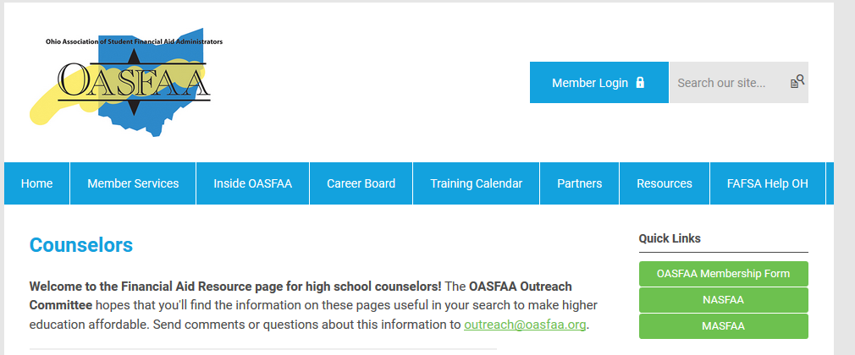
High School Financial Aid Nights
The OASFAA Outreach Committee can help facilitate your school’s Financial Aid presentation even virtually. If you would like a presentation, please complete a request for a presenter on the OASFAA website.
A pre-recorded session will be available.

Slide 45
Financial aid counselor workshops
Half-day agenda covering various financial aid & FAFSA topics in depth.
Host site/Location | Date | Time
Ohio University Zanesville | October 14th | 9:30 am - 12:00 pm
Ohio University Southern | October 21st | 9:30 am - 12:00 pm
University of Dayton | October 24th | 9:30 am - 12:00 pm
Baldwin Wallace | October 25th | 9:30 am - 12:00 pm
Columbus State Community College | October 27th | 9:30 am - 12:00 pm
Bluffton University | November 2nd | 9:30 am - 12:00 pm
Ohio University Athens | November 3rd | 9:30 am - 12:00 pm
Virtual Workshop by ZOOM | November 10 (9 - 11) | 9 am - 11 am

Slide 46
Financial Aid Counselor workshops
Basic training on the federal financial aid process and programs.
Targeted at new counselors or advisors or those new to the role of advising seniors.
We will offer 7 in-person workshops and 1 virtual workshop.
Registration will open soon.
Available on the OASFAA Counselor page.
Registration Link: You will receive the link after registering for the event.

Slide 47
Financial Aid 101 Webinar
Basic training on the federal financial aid process and programs.
Targeted at new counselors or advisors or those new to the role of advising seniors.
Will be held on Tuesday, September 27, from 9:00am -10:30am.
Registration is open.
Available on the OASFAA Counselor page.
Registration Link: https://www.oasfaa.org/counselors#fa101

Slide 48
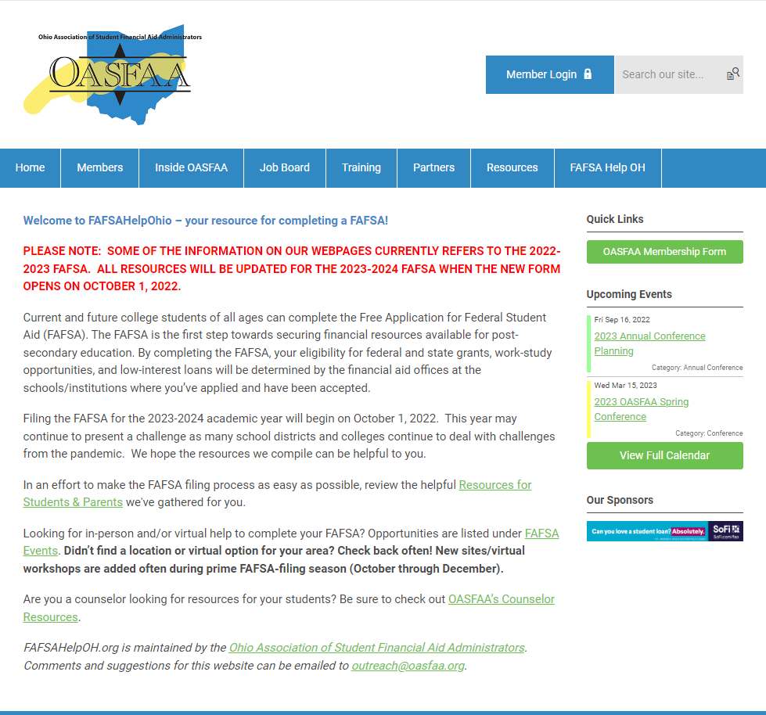
FAFSA HELP OHIO
FAFSA Events
Add any FAFSA events you may be hosting.
Resources for students and parents
Instructional videos
Handouts
You can link this to your school site.

Slide 49
More Counselor Resources
FAFSA Priority Deadlines for Ohio Schools 2022-2023

Slide 50
FAFSA Training Webinars
Thursday, October 6
1:00-2:30pm
Registration is open
Registration link will be available at: https://www.oasfaa.org/counselors
Tuesday, October 11
9:00-10:30am
Registration is open
Registration link will be available at: https://www.oasfaa.org/counselors

Slide 51
QUESTIONS?

