Slide 1
Financial Aid 101
For New Counselors
Fall 2024
These slides will be posted on www.oasfaa.org (Resources/Counselors)
Presenter: Jamie Masters
Title: Financial Aid Advisor
College: Bowling Green State University
Email: outreach@oasfaa.org

Slide 2

About OASFAA & This Presentation
This webinar is sponsored by the Ohio Association of Student Financial Aid Administrators (OASFAA), a non-profit organization comprised of volunteer financial aid professionals.
The OASFAA Outreach Committee is a committee that serves as a primary resource of pertinent and current financial aid information. The committee disseminates this information through a variety of activities including training programs for various stakeholders external to OASFAA such as admissions staff, high school counselors, access advisors, TRIO, etc.

Slide 3
About OASFAA & This Presentation
OASFAA is providing the information today as a free service to counselors.
  You have permission to copy and distribute these materials to your families.
  Charges may not be assessed for the material or for the information presented.
  Permission must be granted for other use of this information or these materials. Contact the OASFAA Outreach Chairperson(s) listed on the OASFAA website or e-mail the OASFAA Outreach Committee at outreach@oasfaa.org.
  The presentation is being recorded and will be available on the OASFAA website along with the presentation slide deck.

Slide 4


Engage with us!
Questions? Click Q&A
Tech issues? Click Chat

Slide 5
Financial Aid 101
This presentation draws on information from OASFAA, the National Association of Student Financial Aid Administrators (NASFAA) and Federal Student Aid (FSA).
Today’s webinar is an introduction to financial aid. For a more in-depth presentation and discussion you are encouraged to attend an OASFAA counselor workshop being offered in October and November.
Notes:
This information is correct as of today…

Slide 6

Let’s get started
This Photo by Unknown Author is licensed under CC BY-SA-NC

Slide 7

Today’s Topics
FAFSA Overview
How to Create an FSA ID
Types of Financial Aid
OASFAA Resources
Question and Answer

Slide 8

Financial aid basics
The federal government looks to BOTH the student and the family to cover educational expenses
Financial aid is designed to assist all families regardless of financial situation
FAFSA = Free Application for Federal Student Aid
Notes:
Avoid being scammed – never pay to complete the FAFSA

Slide 9
The FAFSA form
Application for:
Federal grants, work-study, and federal student loans
State of Ohio grants
For some schools, institutional scholarships and grants
Information Provided:
Demographic (student and parent if dependent)
Taxable and untaxed income for 2023
Students should submit the FAFSA regardless of income!
It’s not the only factor in determining eligibility.
Notes:
Submit a new form every year
Student does not have to be admitted to a school to submit the FAFSA

Slide 10
2025-2026 FAFSA will OPEn On or Before December 1, 2024
Encourage students to check on updated FAFSA priority deadlines at colleges.
FAFSA completion events should begin in mid-December to early January.
Creates a condensed timeframe for FAFSA submission, FAFSA Submission Summary review, verification and aid offer review.

Slide 11

What can students/Parents do right now?
Create an FSA ID TODAY!
Encourage everyone to do this before the FAFSA opens

Slide 12
How to create an FSA ID
Student and parent(s) will each need individual FSA IDs
Go to studentaid.gov – Top right has “Create an account” button
Enter Log-in Information
Enter Personal Information
Enter Mailing Address, Email, Phone and
language preference, Challenge Questions
https://studentaid.gov/fsa-id/create-account/launch
Notes:
People without social security numbers will need to get an FSA ID. They will use the same website to set it up but will have different questions. The signature page is gone.

Slide 13
FSA ID Tips
Phone numbers, SSNs, and emails can only be associated with one FSA ID
Do not use high school email accounts
Both parents should create an FSA ID
Each student filing a FASFA needs an FSA ID
FSA ID should not be shared
Notes:
Make sure to include legal name and DOB

Slide 14
Expected family contribution → Student Aid Index
Index number used by colleges to determine eligibility for aid
Results calculated from information provided on the FAFSA
Same figure reported to all colleges
Not the amount of money owed to the college
Based on ability to pay for college not willingness
Factors that determine the SAI:
  Student and contributor(s) taxable and untaxed income
  Cash, savings, checking balances and assets
  Family Size

Slide 15
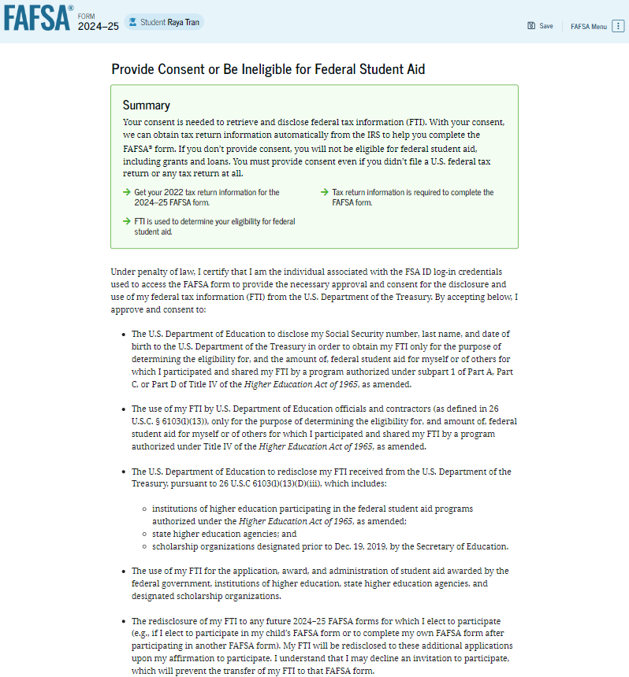
Consent on the fafsa
EVERYONE who contributes to a FAFSA will be required to provide consent to transfer data from the IRS.
This will include non-filers, people without social security numbers, foreign tax filers.
No consent = No federal aid.

Slide 16
FAfSA Dependency status
If any of the following criteria applies, the student is considered independent:
Born before January 1, 2002 (24 years or older)
Married
Pursuing a Master’s or Doctorate Program
Have children or dependents (other than a spouse) that receive more than ½ of their support from the student
Since turning 13, were orphan, ward of the court or in foster care
Legally emancipated minor
Was or is in legal guardianship by someone other than the parent
Student is unaccompanied and either homeless or self-supporting and at risk for homelessness
Currently serving in the U.S. armed forces (other than training) or veteran of the U.S. Armed Forces
Notes:
- If none of these apply, then student must provide information about their parent(s).
- Dependency appeal (estranged relationship, abuse, neglect)

Slide 17
Unusual Circumstances
Does the student have unusual circumstances preventing them from contacting their parents or would contacting their parents pose a risk to the student? Such as:
Left home due to an abusive or threatening environment
Are abandoned by or estranged from their parents
Have refugee or asylee status and are separate from their parents, or their parents are displaced in a foreign country
Victim of human trafficking
Parents are incarcerated and contacting them would pose a risk to the student
Are otherwise unable to contact or locate their parents

Slide 18
Special Circumstances
Conditions exist that cannot be documented with the FAFSA
Family should submit the FAFSA as directed
Contact the financial aid office to discuss the process to appeal based on special circumstances
Appeal process will include: a written explanation and documentation
If approved, financial aid office adjusts the FAFSA
Decisions are final and cannot be appealed to U.S. Department of Education

Slide 19

Special Circumstances
Child Support
Unusual uncovered medical/dental expenses
Extraordinary dependent care
Parent or spouse death
Loss of employment
Divorce

Slide 20
After the fafsa is submitted
Remind students to check their emails and regular mail for FAFSA Submission Summary (previously called the Student Aid Report)
Will receive their award offers – timing varies depending on school
Students should continue to look for scholarships

Slide 21

What is Cost of Attendance (COA)?
Tuition and Fees
Housing and Food (Living expenses)
Books, course materials, supplies and equipment
Transportation
Miscellaneous and Personal
Notes:
Direct and indirect costs

Slide 22
Need Comparison
 | Higher Cost Institution | Mid Cost Institution | Lower Cost Institution
Cost of Attendance | $58,000 | $40,000 | $22,000
-SAI | $8,000 | $8,000 | $8,000
= Need/Eligibility | $50,000 | $32,000 | $14,000
The Student Aid Index (SAI) is the same at each institution.
Notes:
Aid can never be more than the cost of attendance
Each school has their own cost regardless of SAI

Slide 23
Sources of Financial Aid
Federal Government
States
Employers
Private Sources
College and Universities

Slide 24
Types of Financial Aid
Scholarships
Grants
Loans
Work-Study Employment
Self-Help Aid
Gift Aid
Notes:
Scholarships = Free
Grants = Free
Loans = Borrowed Money
Work Study = Money earned through employment

Slide 25
Federal Student Aid Programs
Federal Pell Grant
Federal Supplemental Educational Opportunity Grant (FSEOG)
Teacher Education Assistance for College and Higher Education (TEACH) Grant
Federal Work-Study (FWS)
Federal Direct Student Loans (Direct Loans)
Iraq Afghanistan Service Grant (IASG)
Federal PLUS Loans

Slide 26
Federal Pell/SEOG Grants
Pell Grant (2024-2025)
  Need based grant
  $7,395 maximum Pell
  Federal SEOG Grant: (Campus Based)
  Student must demonstrate exceptional financial need
  Awarded first to students with the lowest SAI (Pell Eligible students are priority)
  Award ranges from $100 to $4,000
FAFSA Priority Deadline for campus-based programs
Notes:
- Maximum, Minimum, & Calculated Pell Grants to be determined by 2023 Federal Poverty Tables.
- Pell Grants between minimum and maximum will be determined by SAI (similar to the way EFC was used).
- Poverty charts are published at the beginning of each calendar year and can be used to predict Pell Grant eligibility.
- There will no longer be Pell Charts. Pell Grant amount is determined by maximum Pell amount minus SAI and rounded to closest $5.
- Pell amount will vary by enrollment intensity, calculated on number of hours registered.

Slide 27
Iraq and Afghanistan service grant (IASG)
Non-need-based grant
Available to students whose parent/guardian died as a result of U.S. military service on or after 9/11/2001
At time of parent death student must have been less than 24 years of age or if age 24 or older must have been enrolled at higher education institution
Student must not be Pell eligible

Slide 28
TEACH GRANT
For students who agree to teach in a high-need field at a school that serves low-income families
Must teach at least 4 years within 8 years of graduation, otherwise it converts into a Direct Unsubsidized Loan
Up to 3,772 per year
Specific majors are eligible

Slide 29
Federal Work-Study
Undergraduate or graduate students are eligible
Employment can be on or off campus
FWS wages excluded from future SAI calculation!
Eligible employers
  School
  Federal, state, or local public agency
  Private non-profit organization in academically relevant jobs
  For-profit organization in academically relevant jobs
  Community service activities
FAFSA Priority Deadline for campus based programs

Slide 30
Federal direct student loans
Subsidized Loans
Government PAYS the accrued interest while student is attending college and other eligible periods.
Based on Financial Need
Fixed Rate: 6.53%
Undergraduate Students
Unsubsidized Loans
The borrower is responsible for the interest for the life of the loan
NOT Based on Financial Need
Fixed Rate:
    6.53% - Undergraduates
    8.08% - Graduates
Undergraduate and graduate students qualify
Notes:
No credit check is required
Depending on grade level and status
5500/6500/7500 or up to 20,500 for graduate students
MPN & EC required

Slide 31
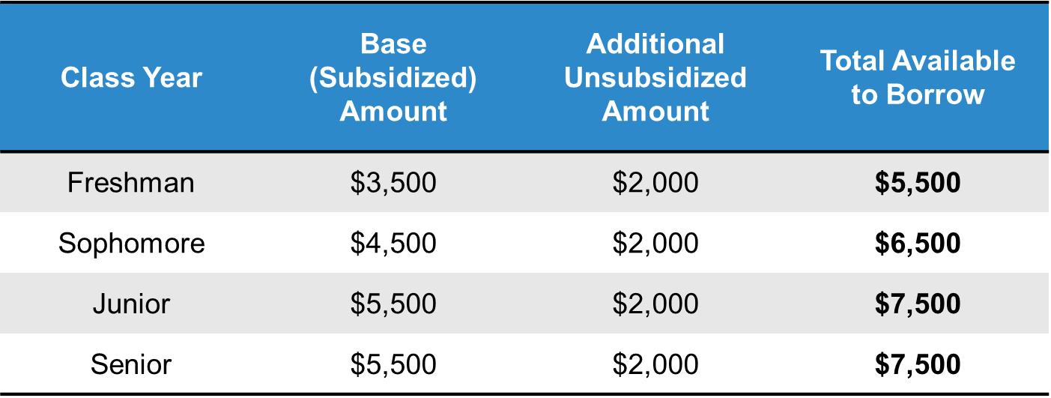
Federal direct student loans

Slide 32
Parent plus loan
Parent is the borrower
Application required at studentaid.gov
Credit check is required
Fixed interest rate: 9.08% (2024-2025)
Repayment options:
60 days after loan has fully disbursed or defer until student graduates
Notes:
There are also graduate plus loans that graduate students can apply for – same interest rate

Slide 33
Ohio Aid Programs
2024-2025
Ohio College Opportunity Grant (OCOG)
Ohio War Orphans Scholarship & Severely Disabled Veteran’s Children’s Scholarship Program
Ohio Army National Guard Scholarship
Ohio Safety Officers College Memorial Fund
Nurse Education Assistance Loan Program (NEALP)
Choose Ohio First Scholarship: STEM Disciplines
Governor’s Merit Scholarship
Ohio Work Ready Grant
College Adoption Grant
Grow Your Own Teacher Scholarship
Visit highered.ohio.gov to learn more!

Slide 34
Scholarship Searches & SCAMS
Scholarship Scams (free vs. paying a fee)
  Buyer beware ☹
Pursue local scholarships!
  Local foundations, Civic Organizations, Churches, Employers, Financial Institutions, etc.
Check with Colleges and Universities
  They may be aware of external scholarships in addition to institutional scholarships
Scholarship Search Engines

Slide 35
OASFAA Resources

Slide 36
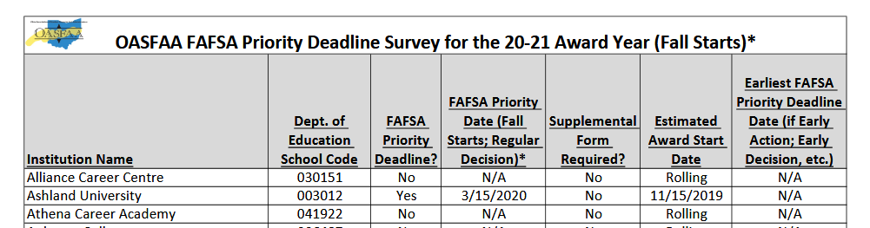
Priority deadlines resource
Follow directions per College or University
What are Ohio colleges and universities doing about deadlines?
  See the OASFAA website under counselor resources for the FAFSA Priority Deadlines for Ohio Schools
Note: There may be other forms and other deadlines…
  Example: CSS College Profile Form
  Early Decision
  Transcripts
  Verification/FA Additional Forms

Slide 37
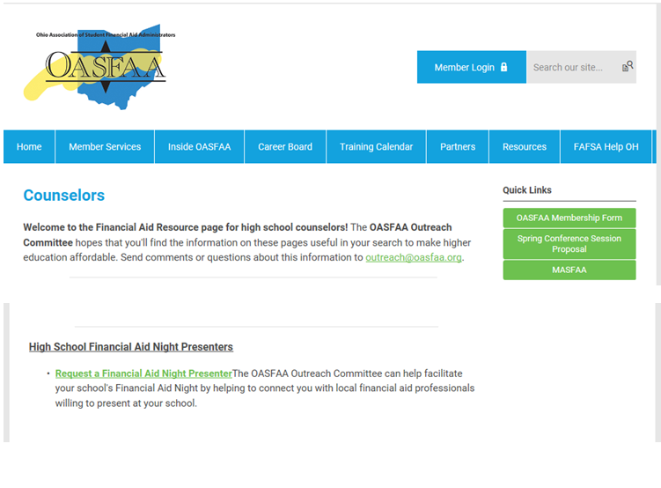
HIGH SCHOOL FINANCIAL AID NIGHTS
The OASFAA Outreach Committee can help facilitate your school's Financial Aid Night by helping to connect you with local financial aid professionals willing to present at your school.

Slide 38
Fall 2024 Counselor Workshops
Registration is requested and is available @ www.oasfaa.org >Resources>Counselors
All in-person workshops are from 9:00am – Noon
OCTOBER
NOVEMBER
Friday, October 11: Ohio University Zanesville
Tuesday, October 15: The Ohio State University
Wednesday, October 16: Ashland University
Tuesday, October 22: University of Northwestern Ohio
Tuesday, October 22: University of Dayton
Friday, October 25: Wilmington College
Tuesday, October 29: Ohio University Athens
Friday, November 1: Ohio University Chillicothe
Thursday, November 7: Sinclair Community College
Friday, November 8: Kent State University
Friday, November 15: Shawnee State University
Friday, November 22: Bowling Green State University
Friday, November 22: Stark State University
Monday, November 25: Virtual Counselor Workshop

Slide 39
OASFAA Outreach
OASFAA EMAIL: OUTREACH@OASFAA.ORG
Web: http://www.oasfaa.org/ (page for counselors)
Request an OASFAA volunteer High School Financial Aid Night presenter
Register for the Counselor Workshops
Sign up for our email database to be sure you are notified for all events.

Slide 40

Questions

